Slide 1

Chapter 14
Entity Authentication
Copyright © The McGraw-Hill Companies, Inc. Permission required for reproduction or display.
14.<number>

Slide 2
Chapter 14
Objectives
To distinguish between message authentication and
entity authentication
To define witnesses used for identification
To discuss some methods of entity authentication
using a password
To introduce some challenge-response protocols for
entity authentication
To introduce some zero-knowledge protocols for
entity authentication
To define biometrics and distinguish between
physiological and behavioral techniques
14.<number>

Slide 3
14-1 INTRODUCTION
Entity authentication is a technique designed to let one party prove the identity of another party. An entity can be a person, a process, a client, or a server. The entity whose identity needs to be proved is called the claimant; the party that tries to prove the identity of the claimant is called the verifier.
Topics discussed in this section:
14.1.1 Data-Origin Versus Entity Authentication
14.1.2 Verification Categories
14.1.3 Entity Authentication and Key Management
14.<number>

Slide 4
14.1.1 Data-Origin Versus Entity Authentication
There are two differences between message authentication (data-origin authentication), discussed in Chapter 13, and entity authentication, discussed in this chapter.
Message authentication might not happen in real time; entity authentication does.
Message authentication simply authenticates one message; the process needs to be repeated for each new message. Entity authentication authenticates the claimant for the entire duration of a session.
14.<number>

Slide 5
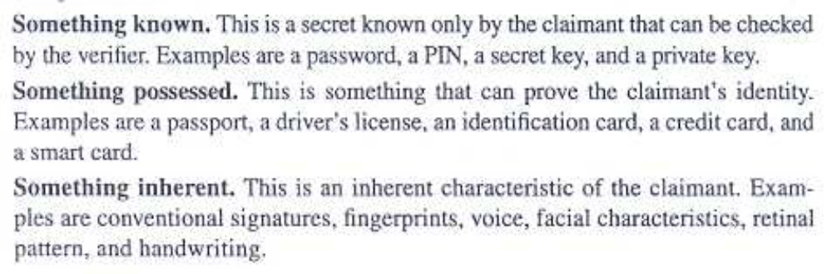
14.1.2 Verification Categories
Something known
Something possessed
Something inherent
14.<number>

Slide 6
14.1.3 Entity Authentication and Key Management
This chapter discusses entity authentication. The next chapter discusses key managment.
14.<number>

Slide 7
14-2 PASSWORDS
The simplest and oldest method of entity authentication is the password-based authentication, where the password is something that the claimant knows.
Topics discussed in this section:
14.2.1 Fixed Password
14.2.2 One-Time Password
14.<number>

Slide 8
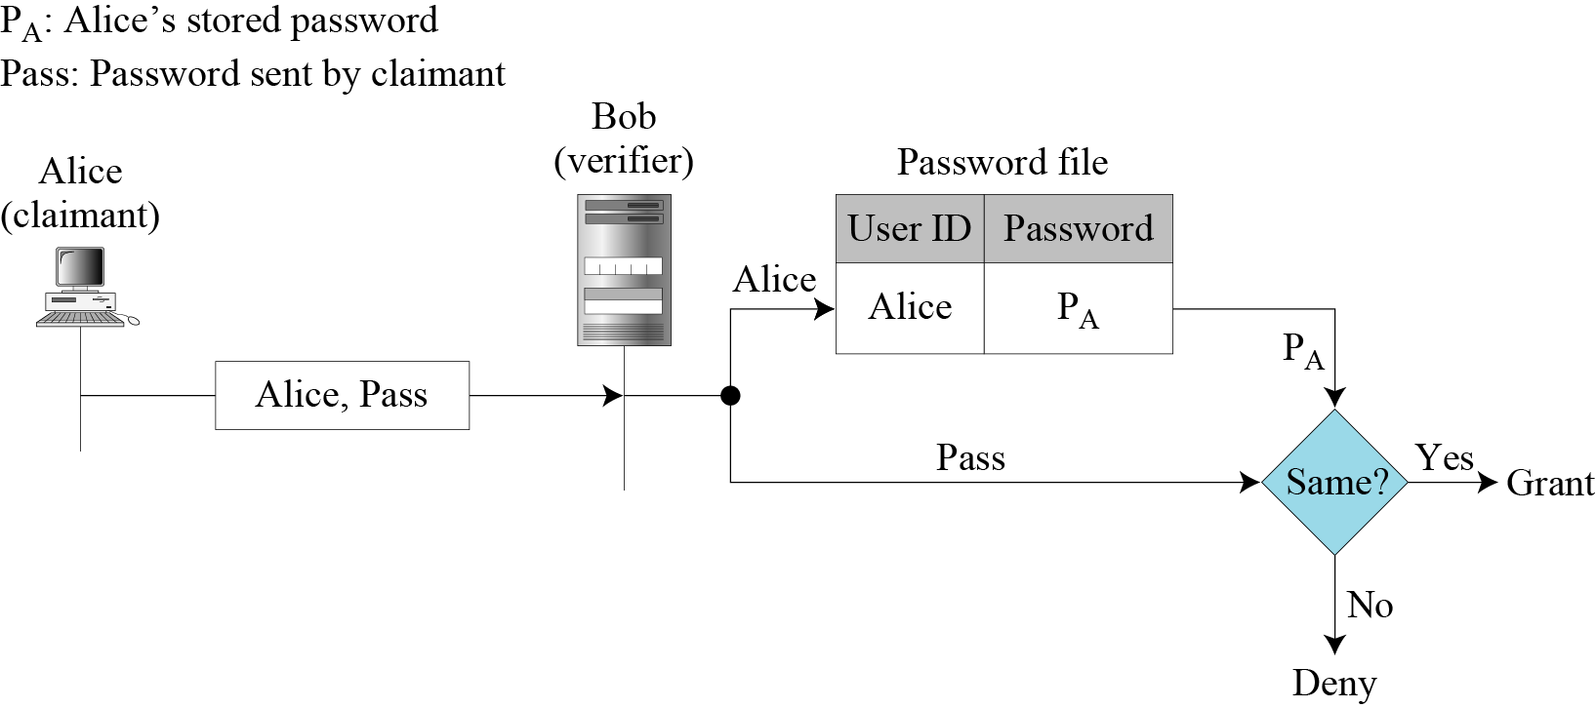
14.2.1 Fixed Password
First Approach
Figure 14.1 User ID and password file
14.<number>
Notes:
Pg. 417 of Behrouz PDF(439 in search bar) and from there continue reading…….

Slide 9
14.2.1 Fixed Password
First Approach: Attacks
Eavesdropping
Stealing a password
Accessing a password file
Guessing
14.<number>

Slide 10
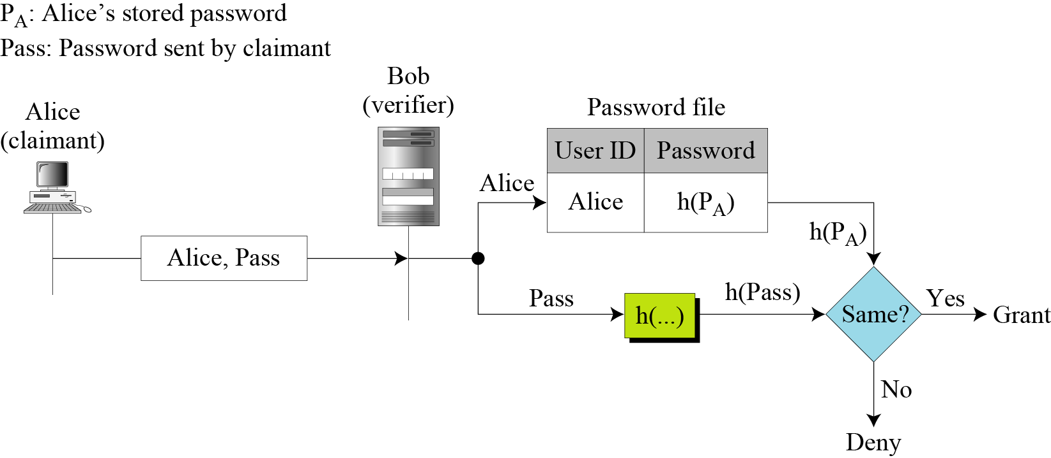
14.2.1 Continued
Second Approach
Figure 14.2 Hashing the password
14.<number>

Slide 11
14.2.1 Continued
Second Approach: Attacks
Dictionary Attack
14.<number>

Slide 12
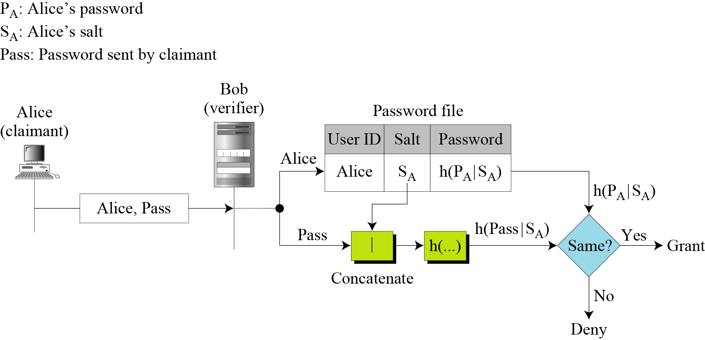
14.2.1 Continued
Third Approach
Figure 14.3 Salting the password
14.<number>

Slide 13
14.2.1 Continued
Fourth Approach
In the fourth approach, two identification techniques are combined. A good example of this type of authentication is the use of an ATM card with a PIN (personal identification number).
14.<number>

Slide 14
14.2.2 One-Time Password
First Approach
In the first approach, the user and the system agree upon a list of passwords.
Second Approach
In the second approach, the user and the system agree to sequentially update the password.
Third Approach
In the third approach, the user and the system create a sequentially updated password using a hash function.
14.<number>
Notes:
First Approach Drawbacks:
1)The user and system have to agree upon a long list of passwords.
2)If there is no sequential access then the password needs to be searched
3)It makes eavesdropping and reuse of the password useless
Second Approach: The user and system agree on a password P1.During the first access the new password P2 is generated using P1 as key. P2 is the password for second access.
Drawback: If Eve knows the P1 all passwords can be guessed

Slide 15
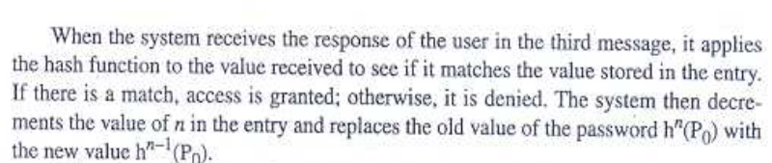
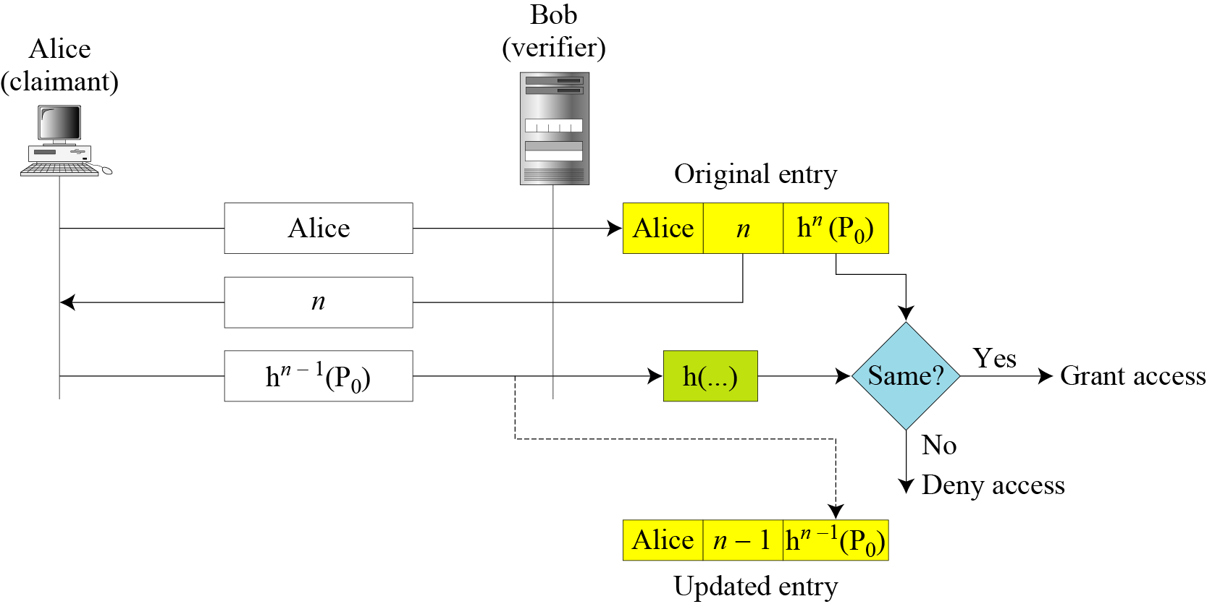
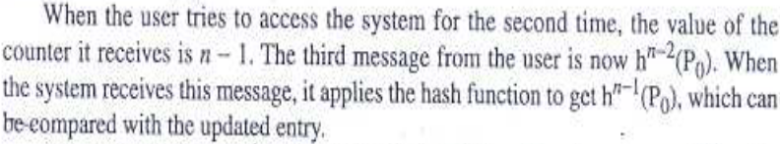
14.2.2 Continued
Figure 14.4 Lamport one-time password
14.<number>

Slide 16
14-3 CHALLENGE-RESPONSE
In password authentication, the claimant proves her identity by demonstrating that she knows a secret, the password. In challenge-response authentication, the claimant proves that she knows a secret without sending it.
Topics discussed in this section:
14.3.1 Using a Symmetric-Key Cipher
14.3.2 Using Keyed-Hash Functions
14.3.3 Using an Asymmetric-Key Cipher
14.3.4 Using Digital Signature
14.<number>

Slide 17

14-3 Continue
Note
In challenge-response authentication, the claimant proves that she knows a secret without sending it to the verifier.
Note
The challenge is a time-varying value sent by the verifier; the response is the result
of a function applied on the challenge.
14.<number>

Slide 18
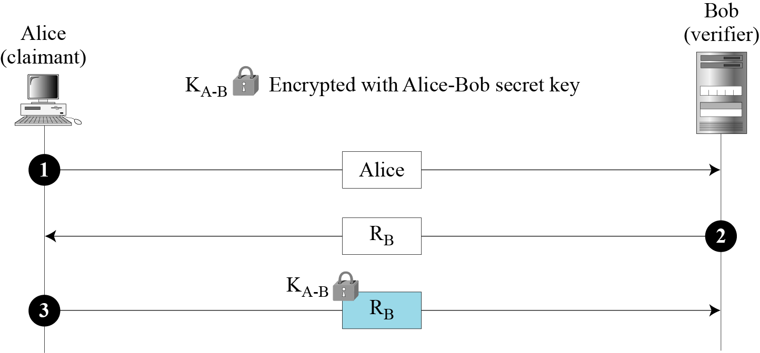
14.3.1 Using a Symmetric-Key Cipher
First Approach
Figure 14.5 Nonce challenge
14.<number>

Slide 19
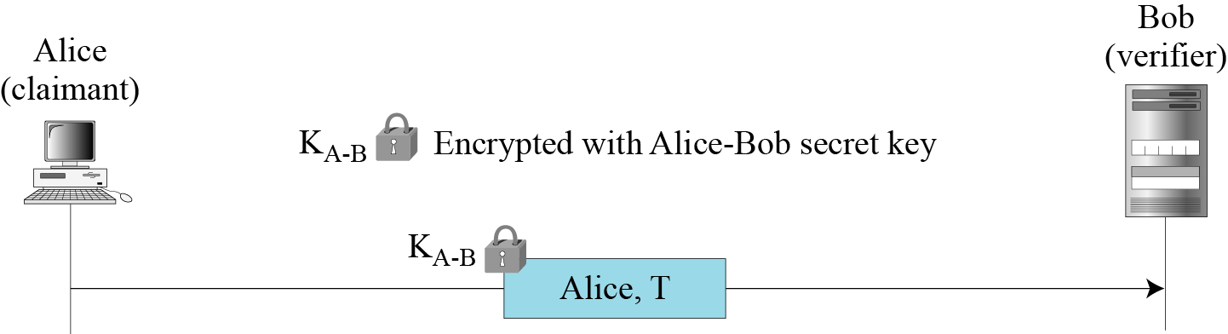
14.3.1 Continued
Second Approach
Figure 14.6 Timestamp challenge
14.<number>

Slide 20
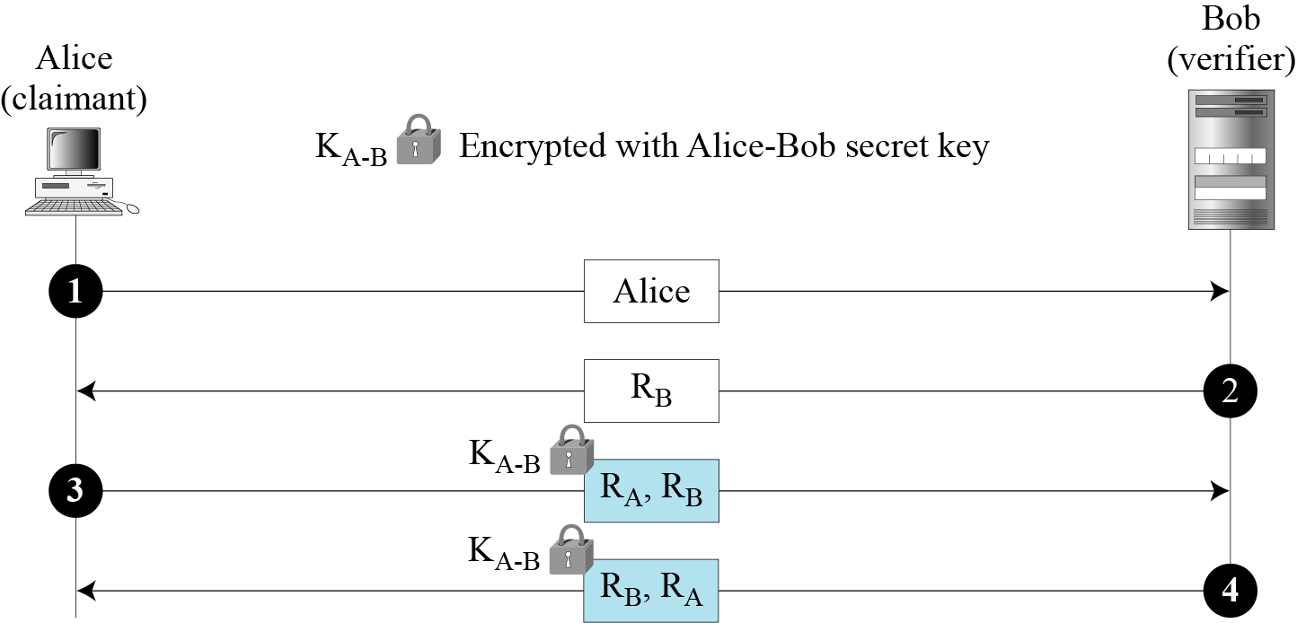
14.3.1 Continued
Third Approach.
Figure 14.7 Bidirectional authentication
14.<number>

Slide 21
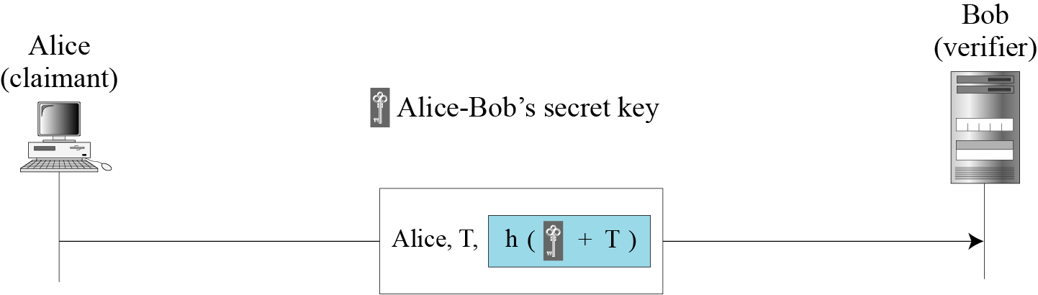
14.3.2 Using Keyed-Hash Functions
Instead of using encryption/decryption for entity authentication, we can also use a keyed-hash function (MAC).
Figure 14.8 Keyed-hash function
14.<number>

Slide 22
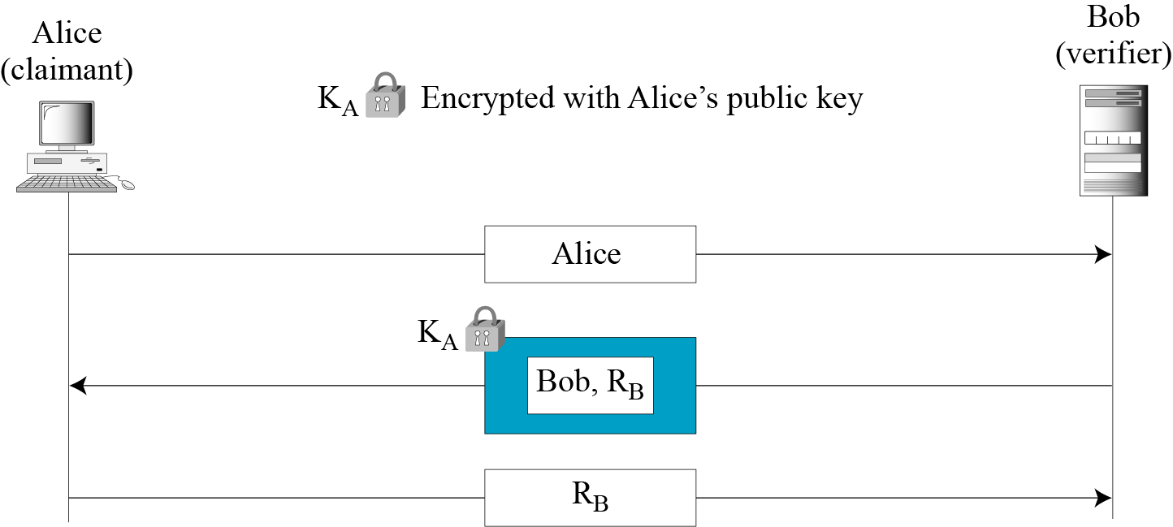
14.3.3 Using an Asymmetric-Key Cipher
First Approach
Figure 14.9 Unidirectional, asymmetric-key authentication
14.<number>

Slide 23
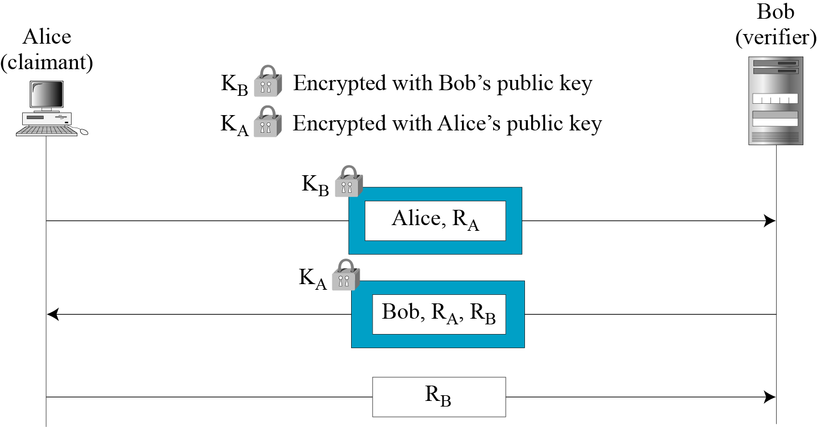
14.3.3 Continued
Second Approach
Figure 14.10 Bidirectional, asymmetric-key
14.<number>

Slide 24
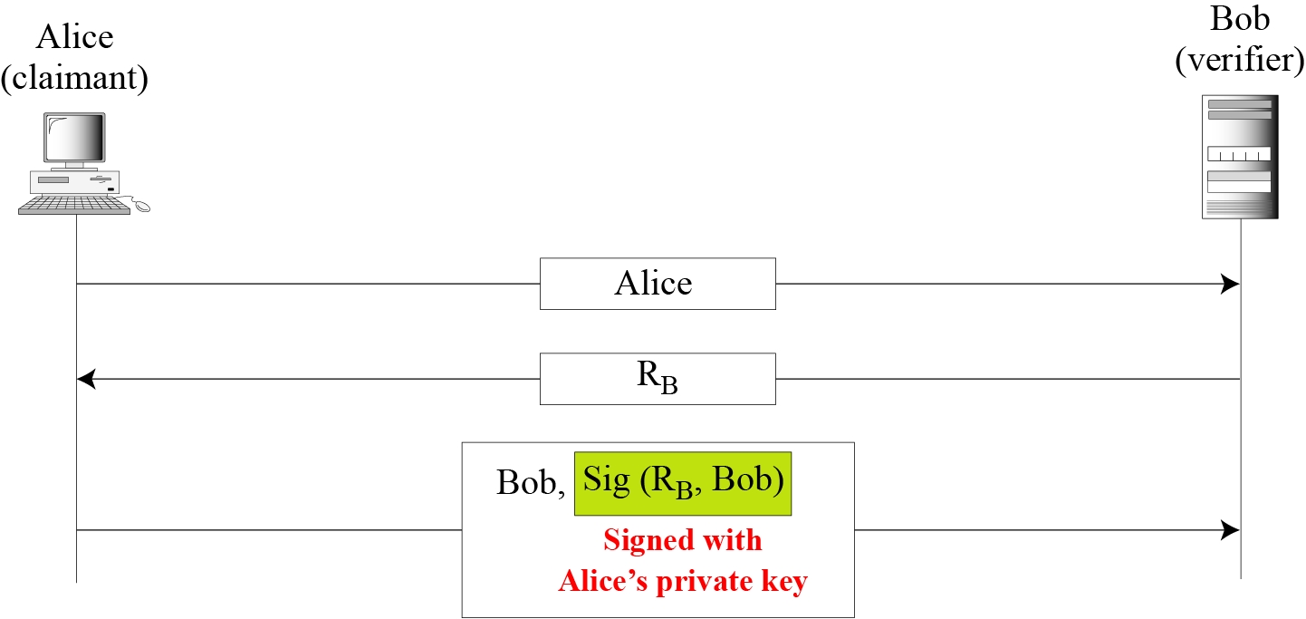
14.3.4 Using Digital Signature
First Approach
Figure 14.11 Digital signature, unidirectional
14.<number>

Slide 25
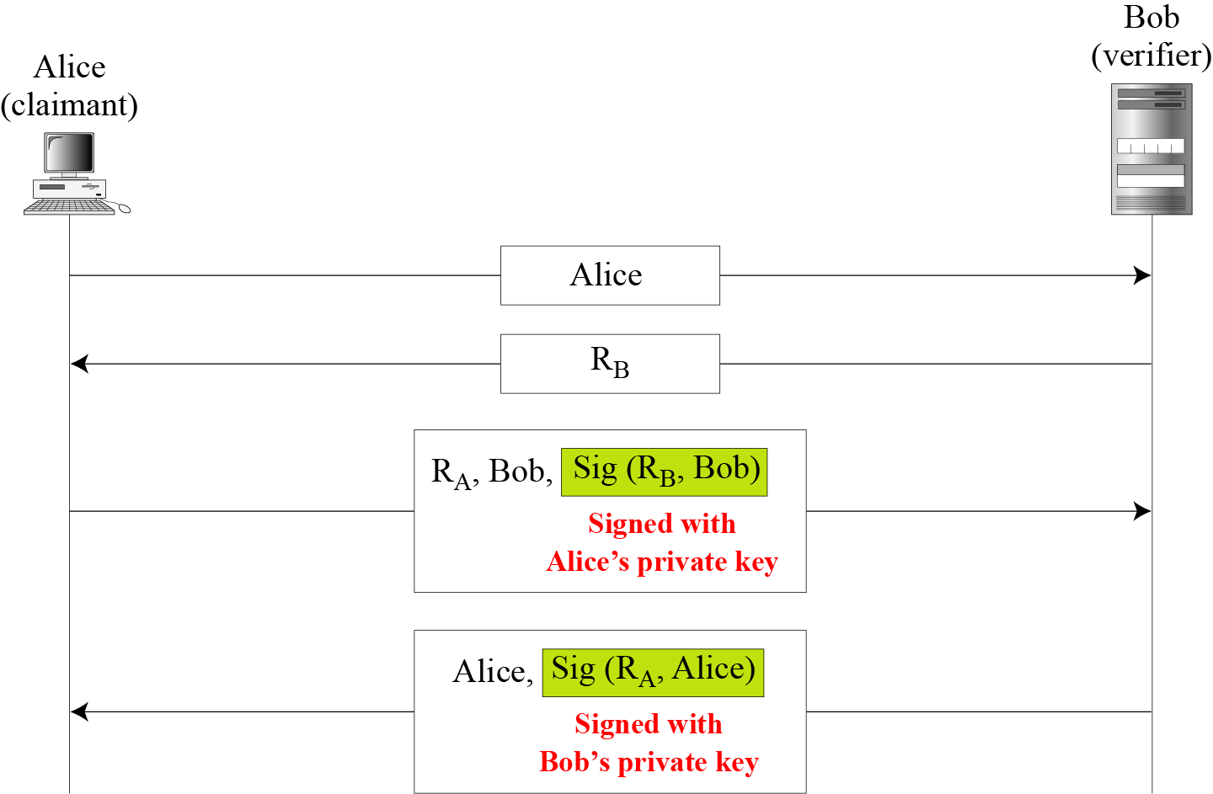
14.3.4 Continued
Second Approach
Figure 14.12 Digital signature, bidirectional authentication
14.<number>

Slide 26
14-4 ZERO-KNOWLEDGE
In zero-knowledge authentication, the claimant does not reveal anything that might endanger the confidentiality of the secret. The claimant proves to the verifier that she knows a secret, without revealing it. The interactions are so designed that they cannot lead to revealing or guessing the secret.
Topics discussed in this section:
14.4.1 Fiat-Shamir Protocol
14.4.2 Feige-Fiat-Shamir Protocol
14.4.3 Guillou-Quisquater Protocol
14.<number>

Slide 27
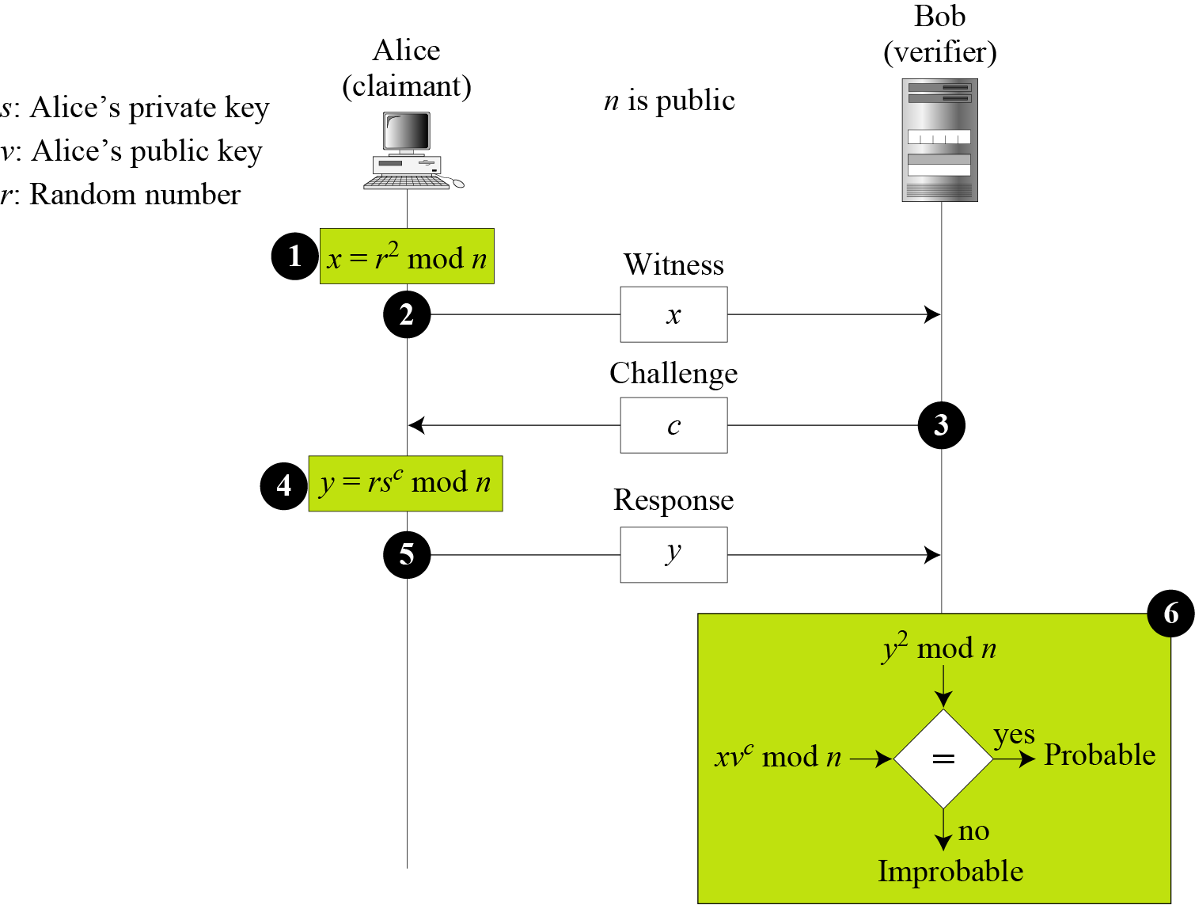
14.4.1 Fiat-Shamir Protocol
Figure 14.13 Fiat-Shamir protocol
14.<number>

Slide 28
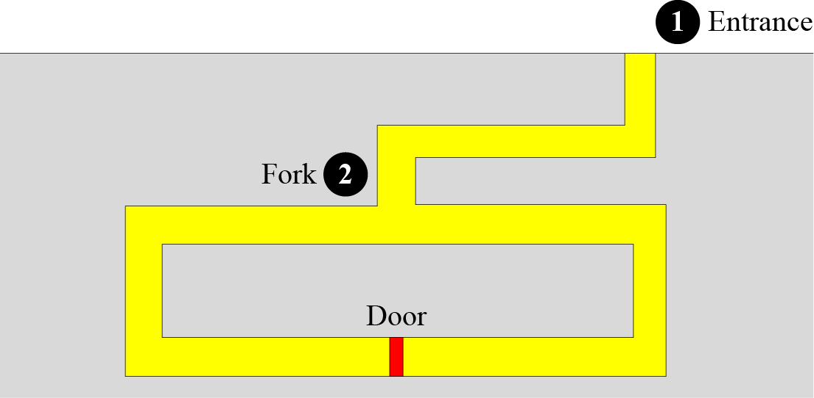
14.4.1 Continued
Cave Example
Figure 14.14 Cave example
14.<number>

Slide 29
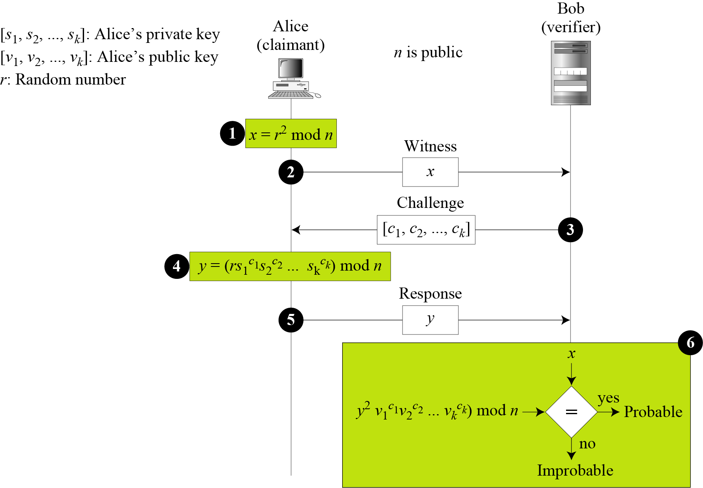
14.4.2 Feige-Fiat-Shamir Protocol
Figure 14.15 Feige-Fiat-Shamir protocol
14.<number>

Slide 30
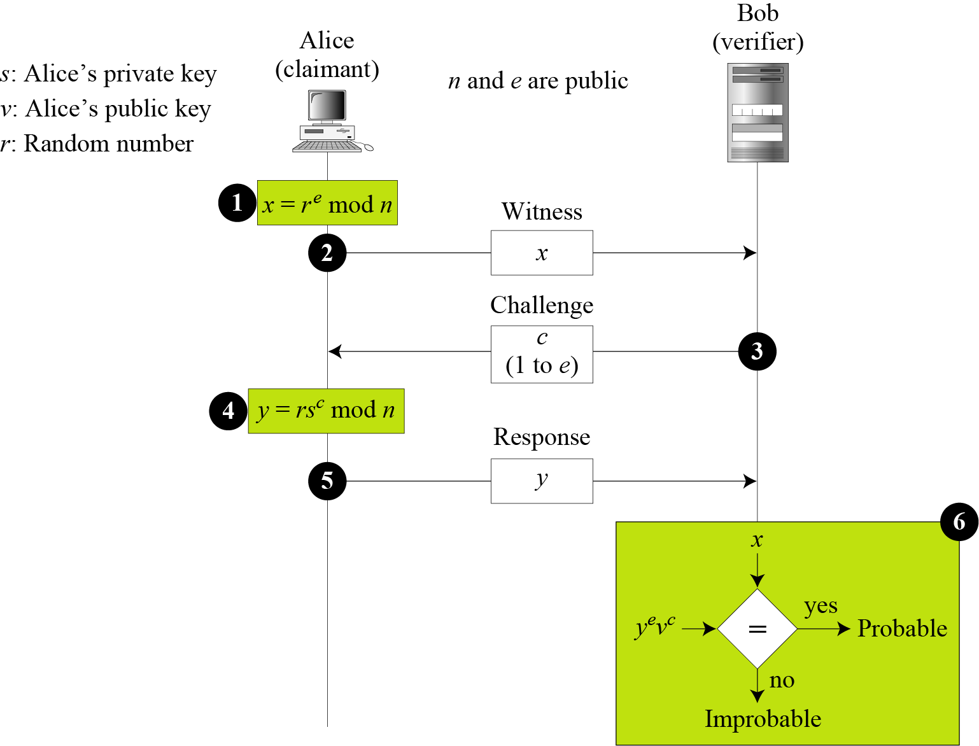
14.4.3 Guillou-Quisquater Protocol
Figure 14.16 Guillou-Quisquater protocol
14.<number>

Slide 31
14.4.3 Continued
Figure 14.16 Guillou-Quisquater protocol
14.<number>

Slide 32
14-5 BIOMETRICS
Biometrics is the measurement of physiological or behavioral features that identify a person (authentication by something inherent). Biometrics measures features that cannot be guessed, stolen, or shared.
Topics discussed in this section:
14.5.1 Components
14.5.2 Enrollment
14.5.3 Authentication
14.5.4 Techniques
14.5.5 Accuracy
14.5.6 Applications
14.<number>

Slide 33
14.5.1 Components
Several components are needed for biometrics, including capturing devices, processors, and storage devices..
14.<number>

Slide 34
14.5.2 Enrollment
Before using any biometric techniques for authentication, the corresponding feature of each person in the community should be available in the database. This is referred to as enrollment.
14.<number>

Slide 35
14.5.3 Authentication
Verification
Identification
14.<number>

Slide 36
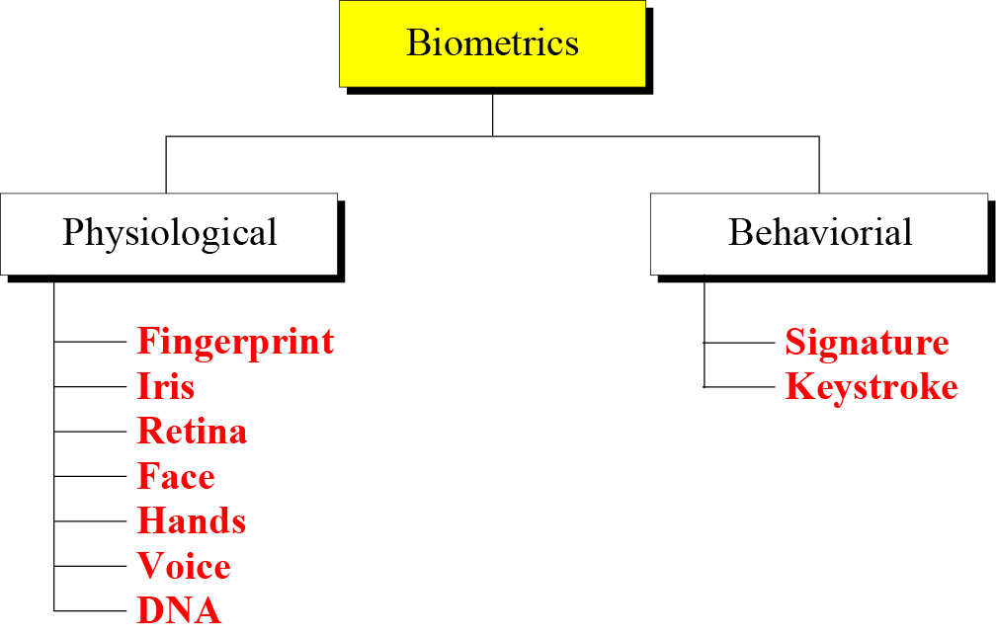
14.5.4 Techniques
Figure 14.17 Techniques
14.<number>

Slide 37
14.5.4 Continued
Physiological Techniques
Fingerprint
Hands
Iris
Voice
Retina
DNA
Face
14.<number>

Slide 38
14.5.4 Continued
Behavioral Techniques
Signature
Keystroke
14.<number>

Slide 39
14.5.5 Accuracy
False Rejection Rate (FRR)
False Acceptance Rate (FAR)
14.<number>

Slide 40
14.5.6 Applications
Several applications of biometrics are already in use. In commercial environments, these include access to facilities, access to information systems, transaction at point-of sales, and employee timekeeping. In the law enforcement system, they include investigations (using fingerprints or DNA) and forensic analysis. Border control and immigration control also use some biometric techniques.
14.<number>

